Slide 1
ANALYSIS OF STUDENT PERFORMANCE
GROUP - 6
SARA NAAZNEEN
MADIRAI
TAFADZWA
KEERTHI

Slide 2
CONTENTS
Data Preprocessing
1
Exploratory Data Analysis
2
Algorithms
3
Summary and Recommendations
4

Slide 3
DATA
ABOUT THE DATA
OBJECTIVE
This data approach student achievement in secondary education of two Portuguese schools. The data attributes include student grades, demographic, social and school related features) and it was collected by using school reports and questionnaires.
The purpose of this study is to identify contextual learning problems in schools and their application in the digital era, where children today tend to return to a perspective that children will learn better if the environment in which they study is a natural environment.
PATH
Implementing multiple machine learning models to fit the best model for the dataset

Slide 4
VARIABLES
school | student's school
sex | student’s sex
age | student's age
address | student's home address
famsize | family size
Pstatus | parent’s cohabitation status
Medu | mother’s education
Fedu | father’s education
Mjob | mother’s job
Fjob | father’s job
reason | reason to choose this school
guardian | student's guardian
traveltime | home to school traveltime
failures | number if past class failures
schoolsup | extra educational support
famsup | family educational support
paid | extra paid class within the course subject
activities | extra-curricular activities
nursery | attended nursery school
higher | wants to take higher education
internet | internet access at home
romantic | with a romantic relationship
famrel | quality of family relationships
freetime | free time after school
goout | going out with friends
Dalc | workday alcohol consumption
Walc | weekday alcohol consumption
health | current health status
absences | number of school absences
G1 | first period grade
G2 | second period grade
G3 | third period grade (output target)

Slide 5
DATA PREPROCESSING
01
ONE
Data preprocessing is an important step in the data mining process. It refers to the cleaning, transforming, and integrating of data in order to make it ready for analysis.

Slide 6


DROPPED COLUMNS
low mi score
address
activities
paid & nursery
traveltime
schoolsup
freetime

Slide 7
DROPPED COLUMNS
does not provide info
Pstatus & guardian
famsize
romantic
famrel
Fjob & health
famsup

Slide 8

MISSING VALUES
NO MISSING VALUES OBSERVED IN THE DATASET.

Slide 9
E D A
02
TWO
Exploratory data analysis (EDA) is used by data scientists to analyze and investigate data sets and summarize their main characteristics, often employing data visualization methods.

Slide 10
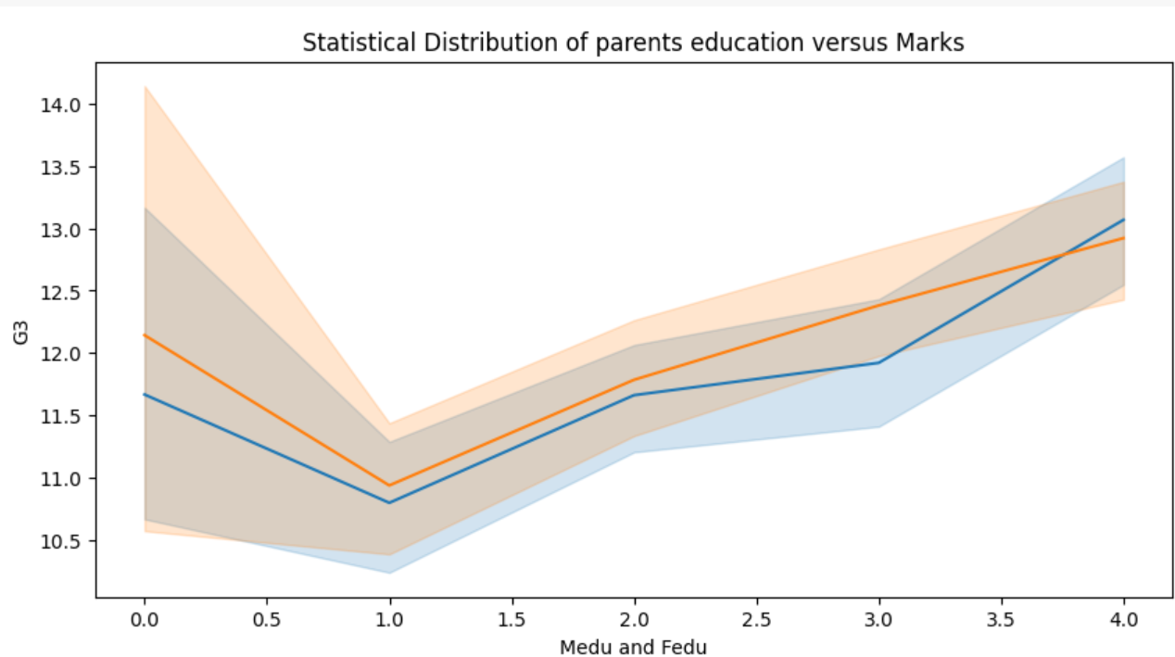
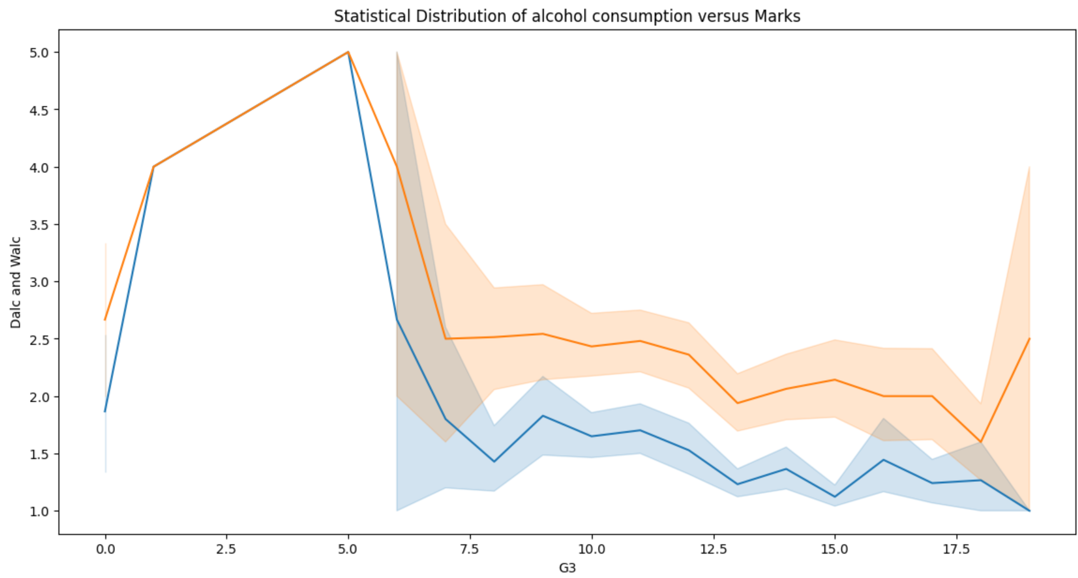
This line plot shows that there is a increase in student performance with the increase in parents education.
This line plot shows that lesser the alcohol consumption (weekday or weekend) the better the student performance.

Slide 11
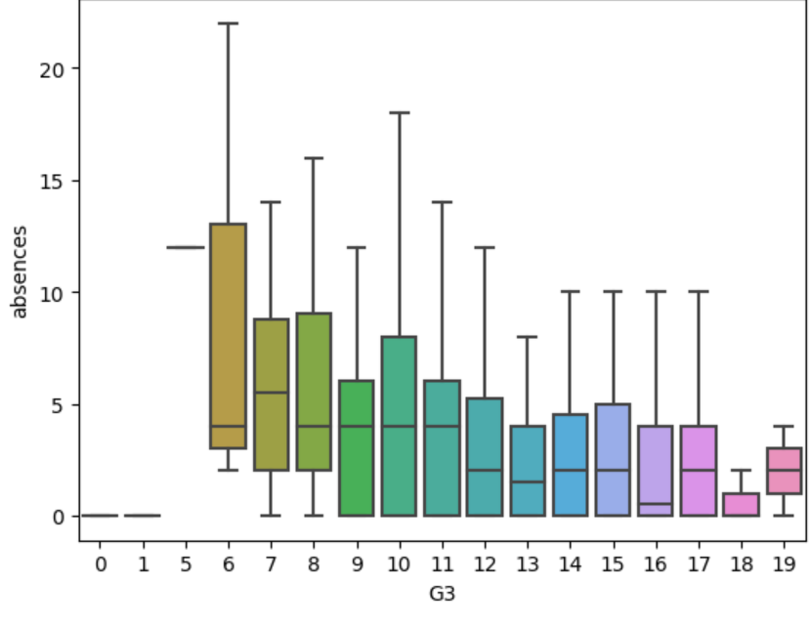
LOGO
BOX PLOT
This boxplot shows that students with higher G3 or the third period grade are less likely to have more number of absences.

Slide 12
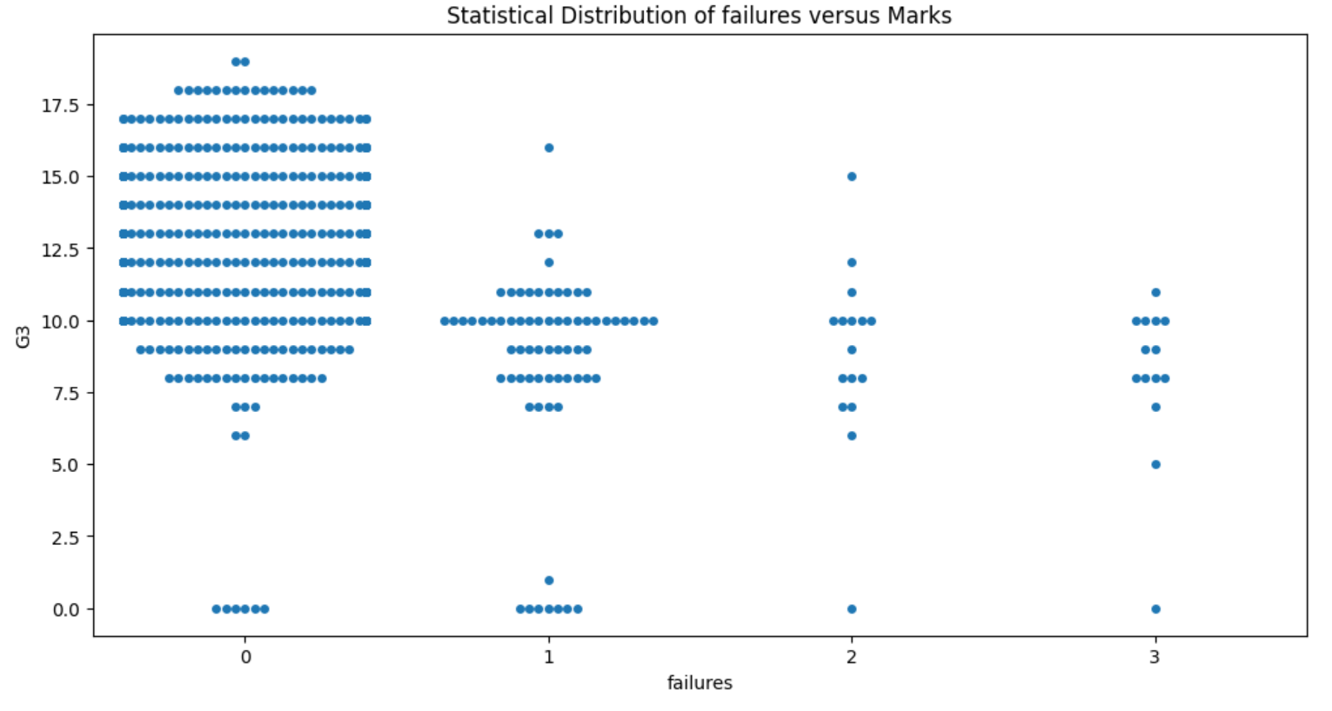
This swarmplot shows the relation between G3 and failures.A students having 1 or more failures has significantly less G3 marks.

Slide 13
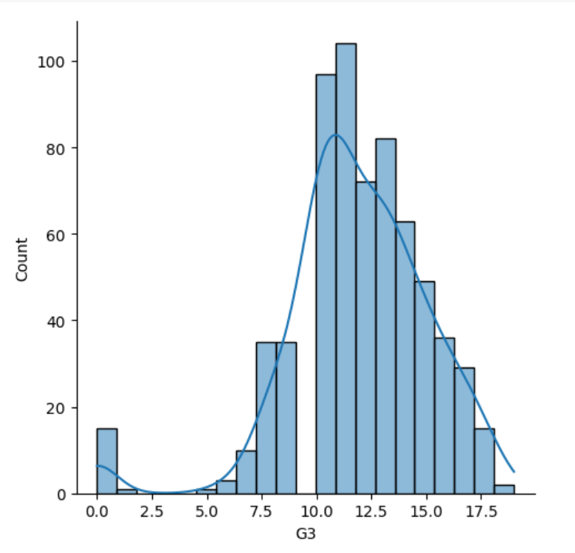
LOGO
KDE
This kdeplot shows the majority of students score between 10 to 15 marks in G3.

Slide 14
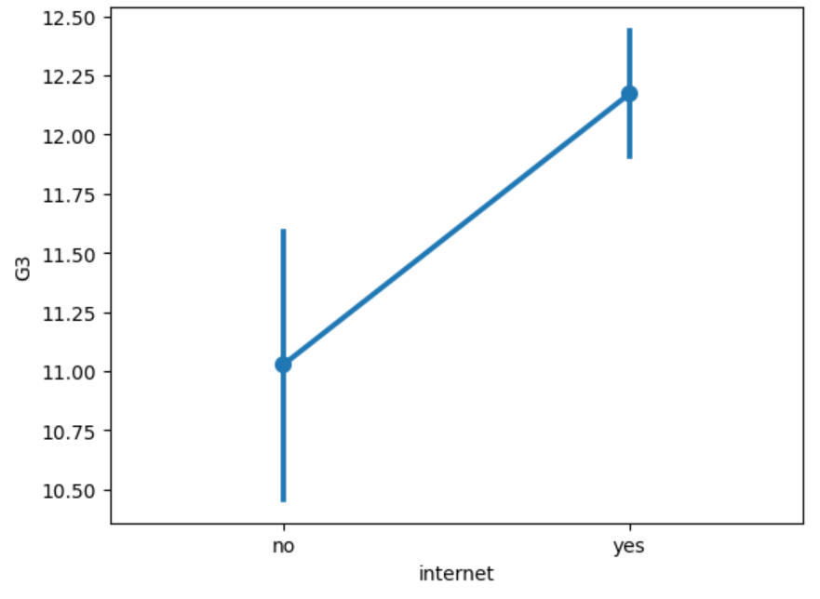
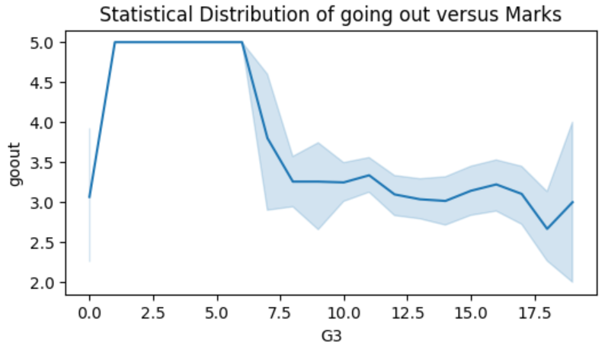
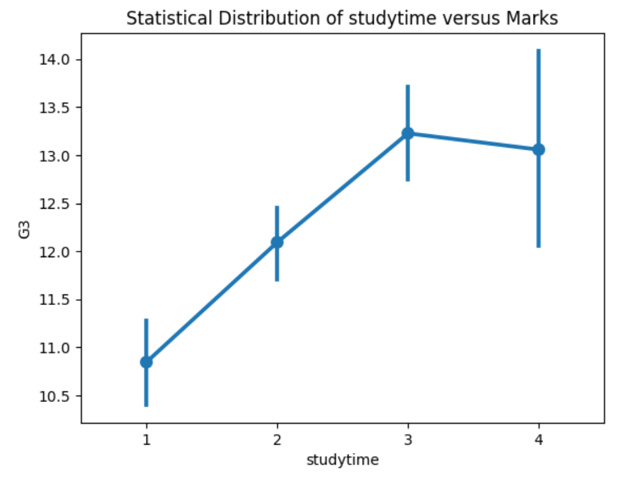
This line plot shows that student performance increase with decrease in going out.
The next two pointplot signifies the positive correlation between internet,studytime and G3.

Slide 15
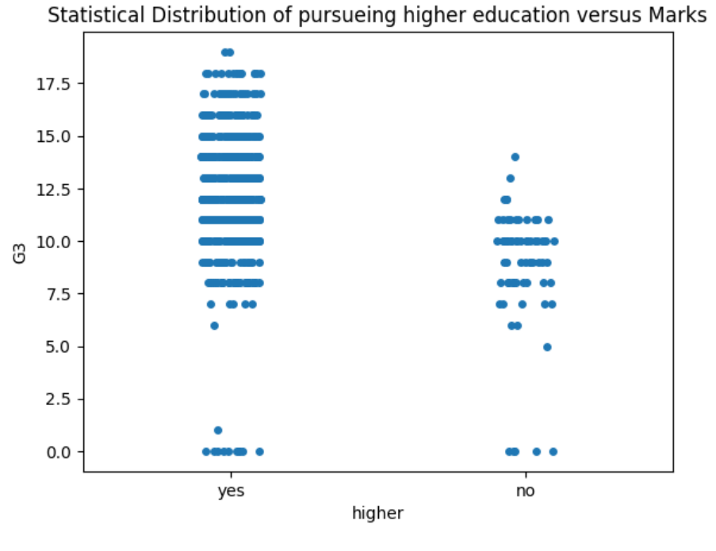
STRIPPLOT
Click here to add the text, the text is the extraction of your thought, please try to explain your point of view as succinctly as possible.
Student who want to pursue higher education tends to score higher than the ones who don't want to pursue higher education.
Click here to add the text, the text is the extraction of your thought, please try to explain your point of view as succinctly as possible.

Slide 16
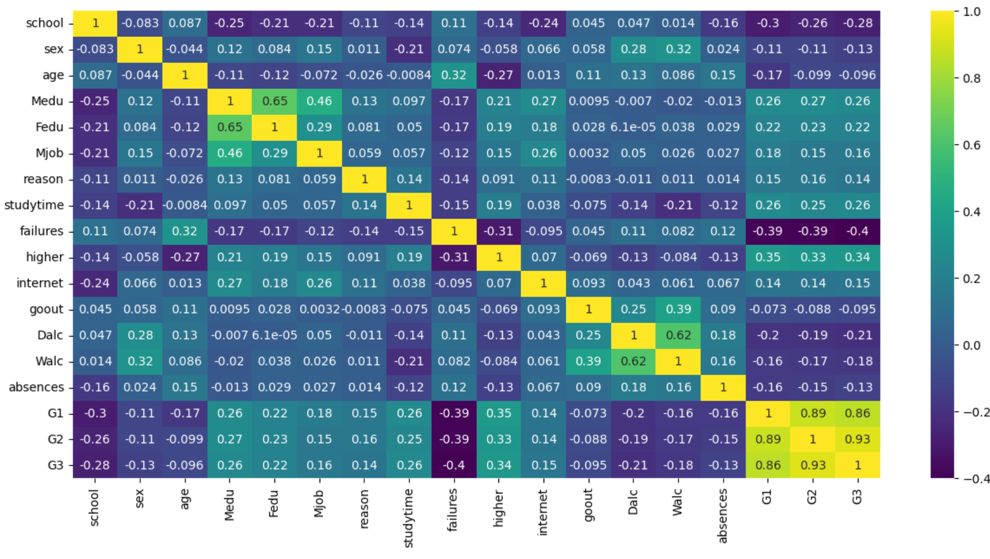
HEATMAP
Enter Title
Enter title
Enter title
Enter title
As shown in the heatmap the variables G1and G2 have very high positive correlation with G3.
Dalc,failures and absences have high negative correlation with G3.
The variables higher, studytime, Medu,Fedu,reason,Mjob are positively correlated with G3.

Slide 17
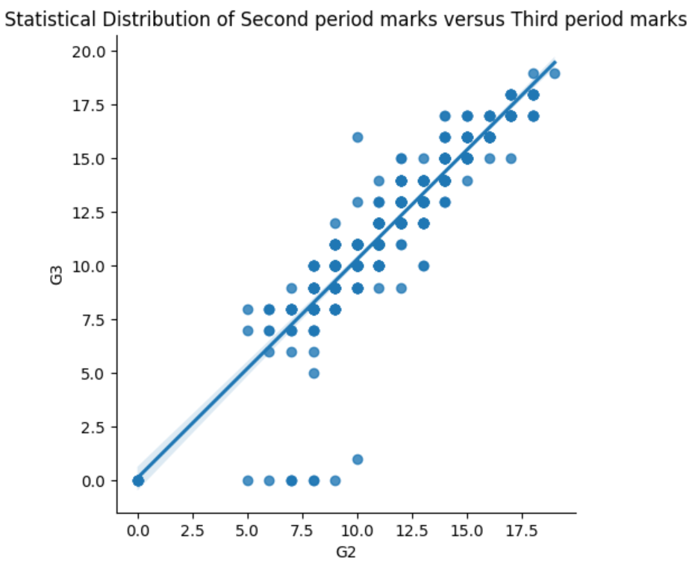
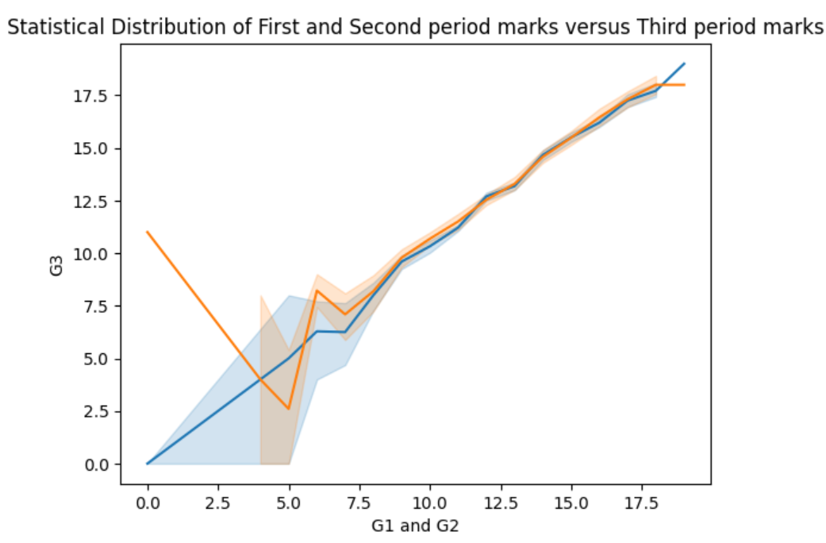
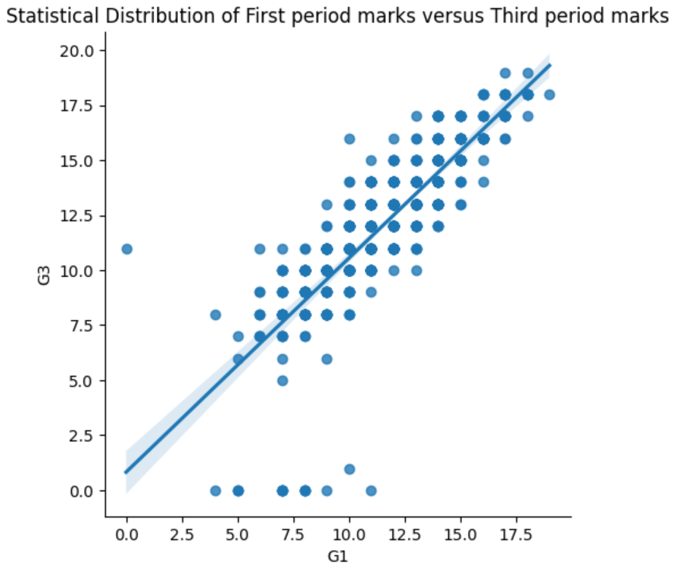
By both lineplot and lmplot it is clear that G1 and G2 have very correlation with G3.

Slide 18
NOTE:
The target attribute G3 has a strong correlation with attributes G2 and G1. This occurs because G3 is the final year grade (issued at the 3rd period), while G1 and G2 correspond to the 1st and 2nd period grades. It is more difficult to predict G3 without G2 and G1, but such prediction is much more useful.
That is why we have done machine learning algorithms on two datasets,
One with the variables G1 and G2 naming it as DATASET 1.
Second without the variables G1 and G2 naming it as DATASET 2.

Slide 19
ALGORITHMS
03
THREE
A machine learning algorithm is the method by which the AI system conducts its task, generally predicting output values from given input data.

Slide 20
DATASET 1
WITH G2 AND G1

Slide 21
LINEAR REGRESSION
0.818
0.794
0.876
0.862
80-20
75-25
70-30
65-35

Slide 22
0.765
DECISION TREE REGRESSOR
0.736
80-20
MAE
75-25
0.866
0.877
70-30
65-35

Slide 23
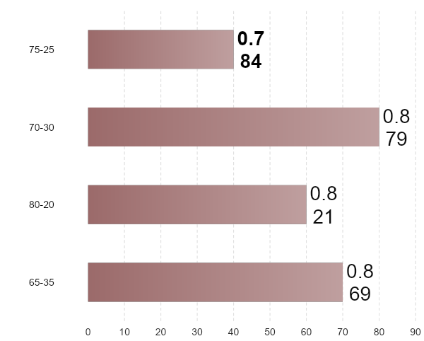
RANDOM FOREST REGRESSOR
MAE SCORES
75 - 25 HAS THE LOWEST MAE VALUE

Slide 24
SUPPORT VECTOR MACHINE (SVM)
1
0.830
2
0.797
80-20
75-25
3
0.882
4
0.964
70-30
65-35

Slide 25
RIDGE REGRESSION
MAE
0.818
0.794
0.876
0.862
80-20
75-25
70-30
65-35

Slide 26
ADA BOOSTING
0.901
0.847
0.961
0.919
80-20
70-30
75-25
65-35

Slide 27
0.786
XGBOOST
0.773
75-25
MAE
80-20
0.930
0.891
70-30
65-35

Slide 28
REGRESSION MODEL | MEAN ABSOLUTE ERROR
LINEAR REGRESSION | 0.794
DECISION TREE REGRESSOR | 0.736
RANDOM FOREST REGRESSOR | 0.784
SVM | 0.797
ADA BOOSTING | 0.847
XGBOOST | 0.773
RIDGE REGRESSOR | 0.794
LOGO
COMPARISON OF IMPLEMENTED MODELS

Slide 29
DATASET 2
WITHOUT G2 AND G1

Slide 30
LINEAR REGRESSION
2.238
2.149
2.362
2.288
80-20
75-25
70-30
65-35

Slide 31
2.307
DECISION TREE REGRESSOR
2.253
80-20
MAE
75-25
2.419
2.350
70-30
65-35

Slide 32

RANDOM FOREST REGRESSOR
MAE SCORES
75 - 25 HAS THE LOWEST MAE VALUE

Slide 33
SUPPORT VECTOR MACHINE (SVM)
1
2.169
2
2.085
80-20
75-25
3
2.261
4
2.460
70-30
65-35

Slide 34
RIDGE REGRESSION
MAE
2.235
2.141
2.357
2.280
80-20
75-25
70-30
65-35

Slide 35
ADA BOOSTING
2.285
2.232
2.374
2.279
80-20
70-30
75-25
65-35

Slide 36
2.270
XGBOOST
2.210
75-25
MAE
80-20
2.313
2.224
70-30
65-35

Slide 37
REGRESSION MODEL | MEAN ABSOLUTE ERROR
LINEAR REGRESSION | 2.149
DECISION TREE REGRESSOR | 2.253
RANDOM FOREST REGRESSOR | 2.081
SVM | 2.085
ADA BOOSTING | 2.232
XGBOOST | 2.210
RIDGE REGRESSOR | 2.141
LOGO
COMPARISON OF IMPLEMENTED MODELS

Slide 38
SUMMARY AND RECOMMENDATIONS
04
FOUR
A machine learning algorithm is the method by which the AI system conducts its task, generally predicting output values from given input data.

Slide 39
SUMMARY
1
For the Student Performance dataset, we performed different types of machine learning algorithms.
2
3
2
From the eda it showed clearly which features that are more and less correlated to target
4
3
The best algorithm is DECISION TREE REGRESSOR with the score of 0.736 with the split 75-25 for the DATASET 1.
1
4
The best algorithm is RANDOM FOREST REGRESSOR with the score of 2.081 with the split 75-25 for the DATASET 2.

Slide 40
RECOMMENDATIONS
Features like G1,G2 higher,studytime, parents education, failures and absences seen in the data visualization have a significant impact on the target G3.
Therefore ,to increase the target G3 , it is necessary to raise the key variables like the studytime and decrease the variables like failures and absences as they lower the target G3.
Even after accounting for the effects if other variables such as G1,G2,higher,studytime and failures are still the basic predictor for G3 in student performance.

Slide 41
THANKS
click here to refer code
open in colab

